Slide 1
Molecular Signaling Within Cells
By: Nicole Phillips

Slide 2
Learning Objectives
Explain mechanisms of altering gene transcription
Describe, in detail, the G protein cycle
Identify different 2nd messengers and describe their role in signal transduction.
Make a diagram of common intracellular signaling cascades

Slide 3
Signal Transduction
Chemical signaling requires 3 components:
  A signal. The molecule that transmits information from one cell to another.
  A receptor that transduces the information from the signal.
  An effector. Molecules that mediate the cellular response (i.e. have an “effect” on the cell)
When this takes place within a cell, it is referred to as intracellular.

Slide 4
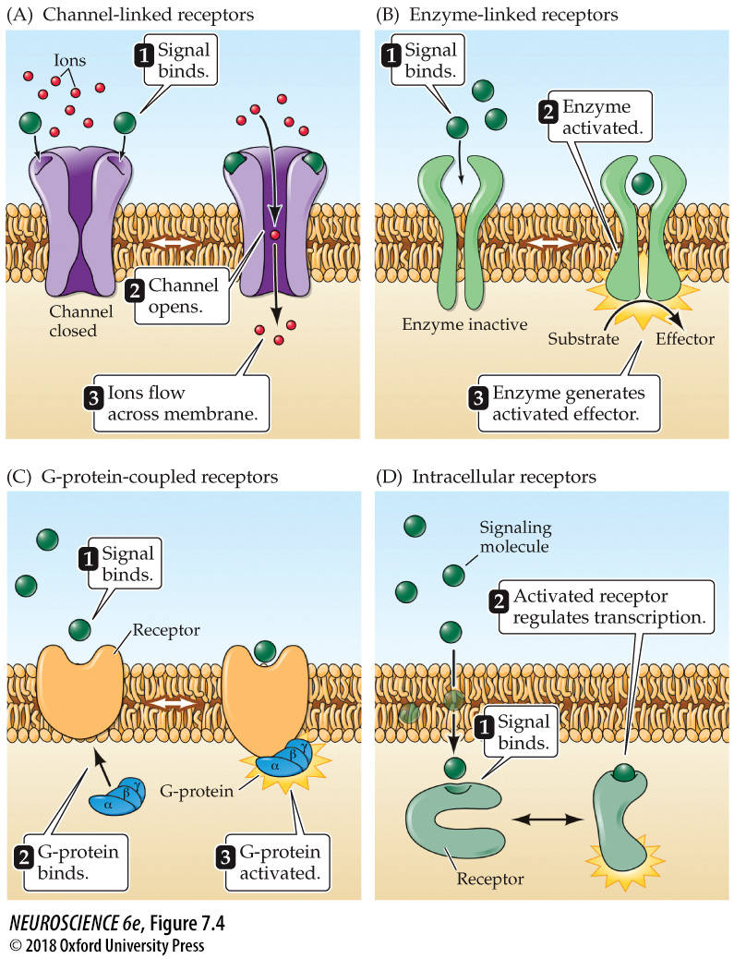
4 Classes of Signal Transduction
More information can be found here: https://www.ncbi.nlm.nih.gov/books/NBK10989/

Slide 5
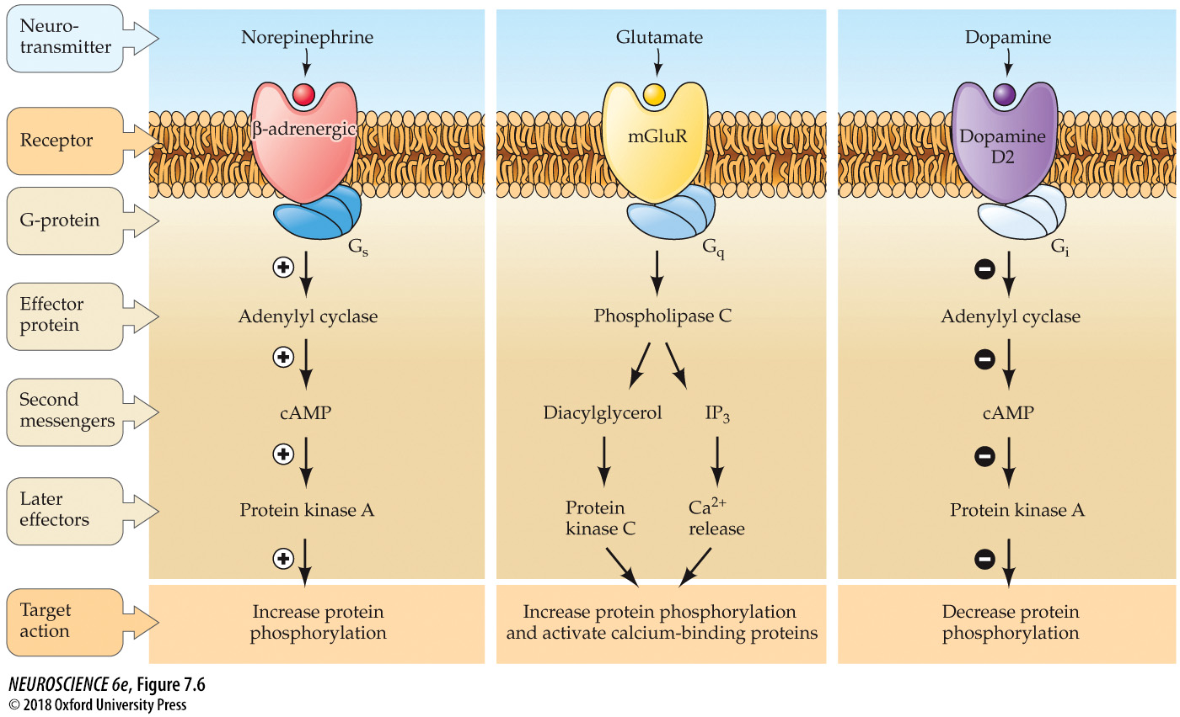
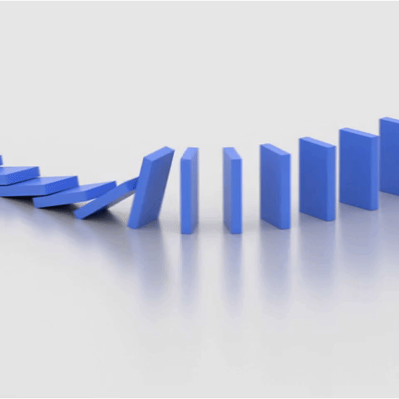
Signaling Cascades
signal
receptor
effectors
https://giphy.com/explore/domino-falling

Slide 6
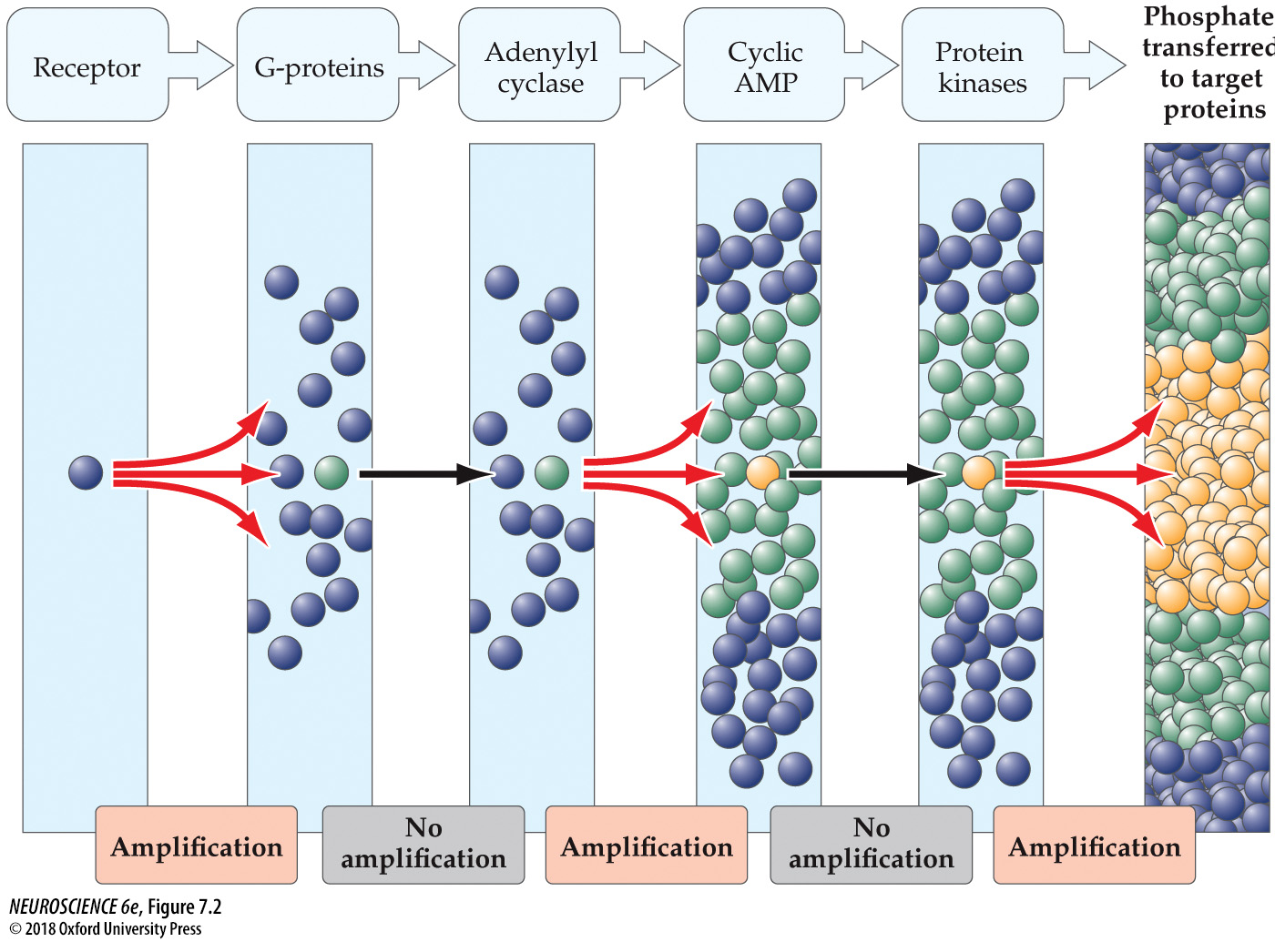
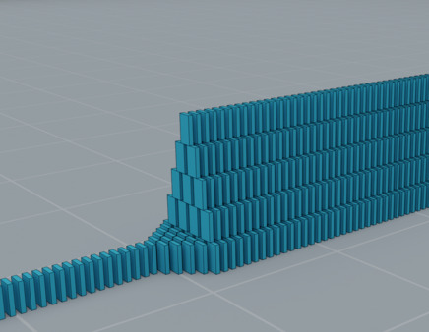
Cascades Allow for Signal Amplification
doi: 10.4161/cl.29391

Slide 7
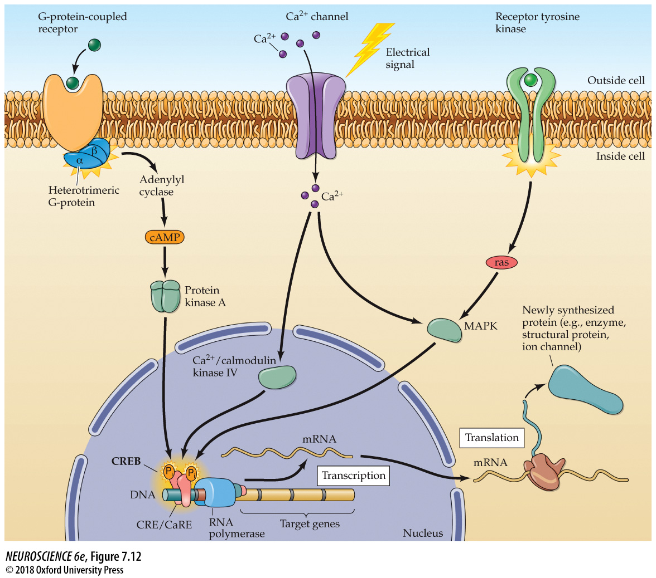
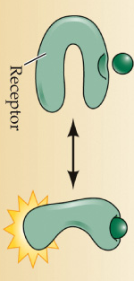
Signal transduction pathways can alter gene transcription through many mechanisms
Metabotropic receptors coupled to 2nd messenger systems
Ca²⁺ influx through voltage-gated or ligand-gated Ca²⁺ channels
Receptor tyrosine kinase signaling
Intracellular receptors

Slide 8

G protein Coupled Receptor Signaling Cascades

Slide 9
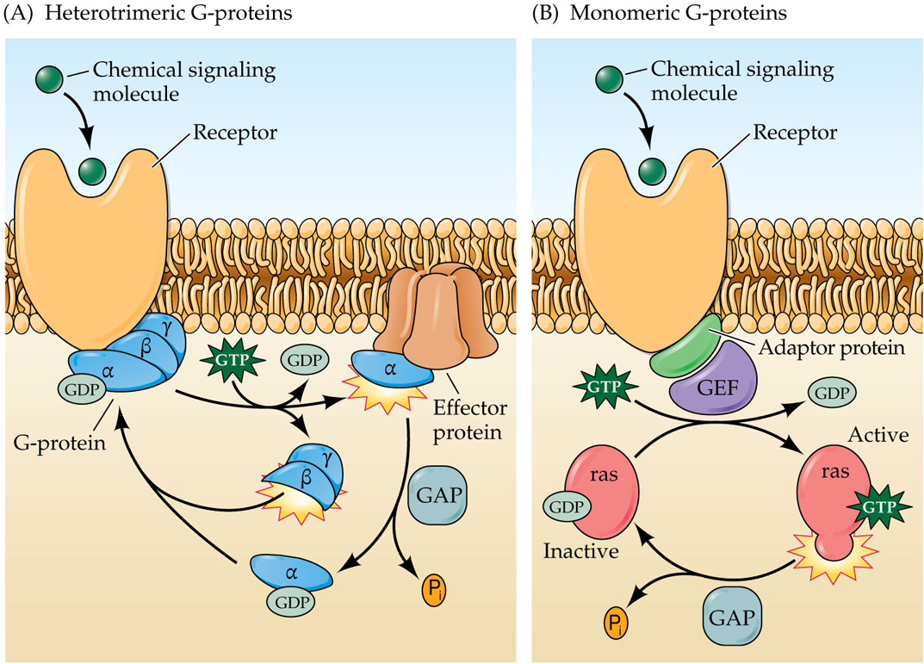
2 classes of G protein coupled receptors
Heterotrimeric
  3 subunits
    α, βγ
Monomeric
  Single subunit
    ras

Slide 10
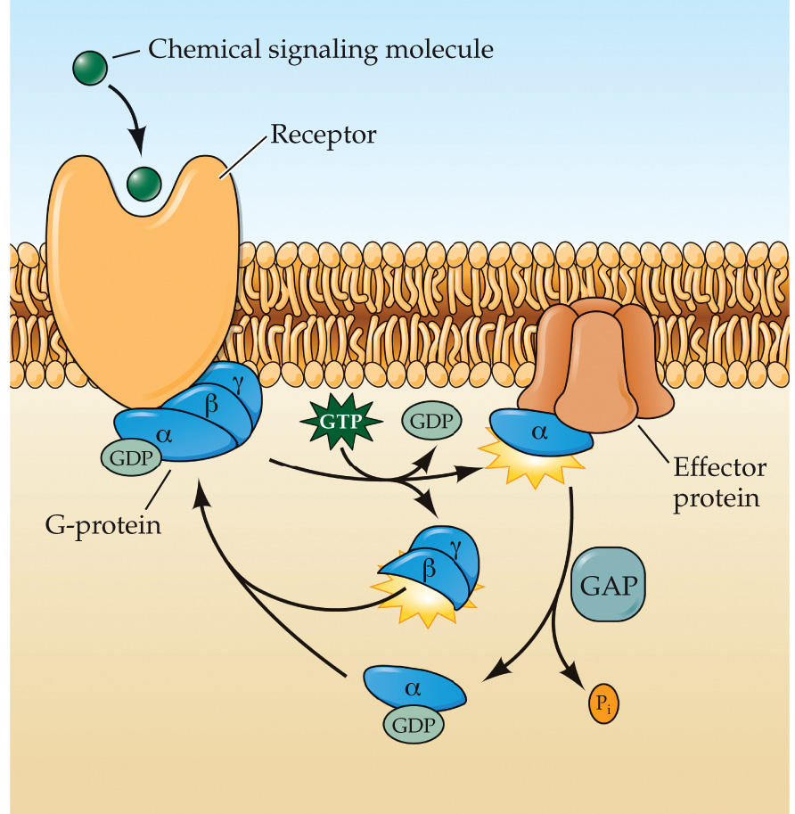
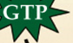
Activation – Inactivation cycle of Heteromeric G proteins
2
Exchange GDP for GTP
1
2
1
3
Inactive
GDP bound
Active
GTP bound
α subunit bound to βγ dimer
α subunit dissociated from βγ dimer
3
4
4
Hydrolyze GTP into GDP

Slide 11
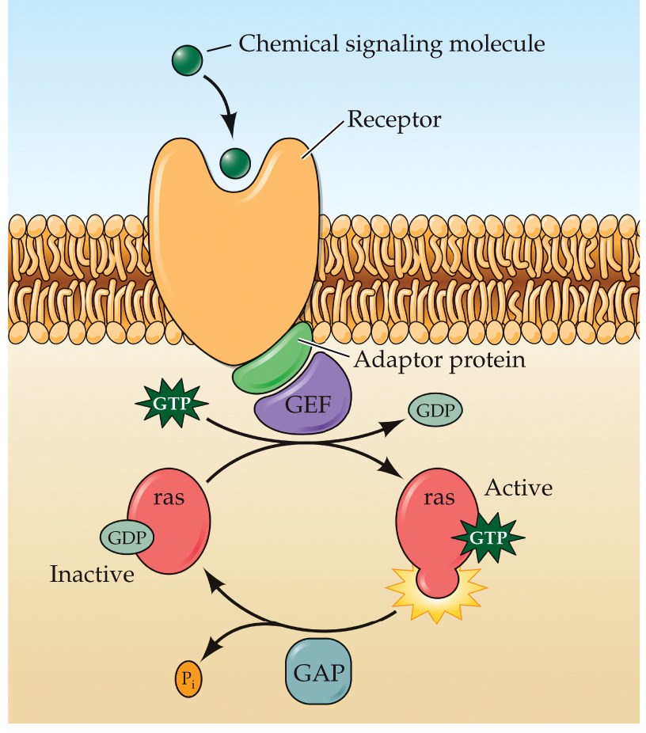
Activation – Inactivation cycle of Monomeric G proteins
2
Exchange GDP for GTP
1
3
Inactive
Active
1
  GDP bound
  GTP bound
2
3
Hydrolyze GTP into GDP
4
4

Slide 12

Effector Proteins Activated by G proteins
Many effector proteins are enzymes that produce 2nd messengers.
Different G protein subunits activate/inactivate different effectors.
Examples:
  G_{s} → stimulates adenylyl cyclase (AC)
  G_{i} → inhibits AC
  G_{q}→ stimulates phospholipase C

Slide 13
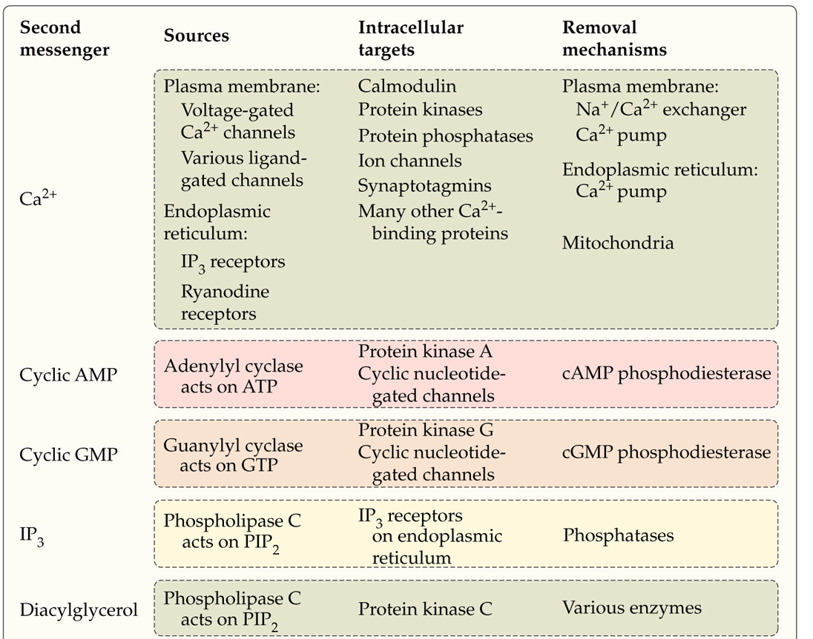
Several chemicals can serve as 2nd messengers

Slide 14
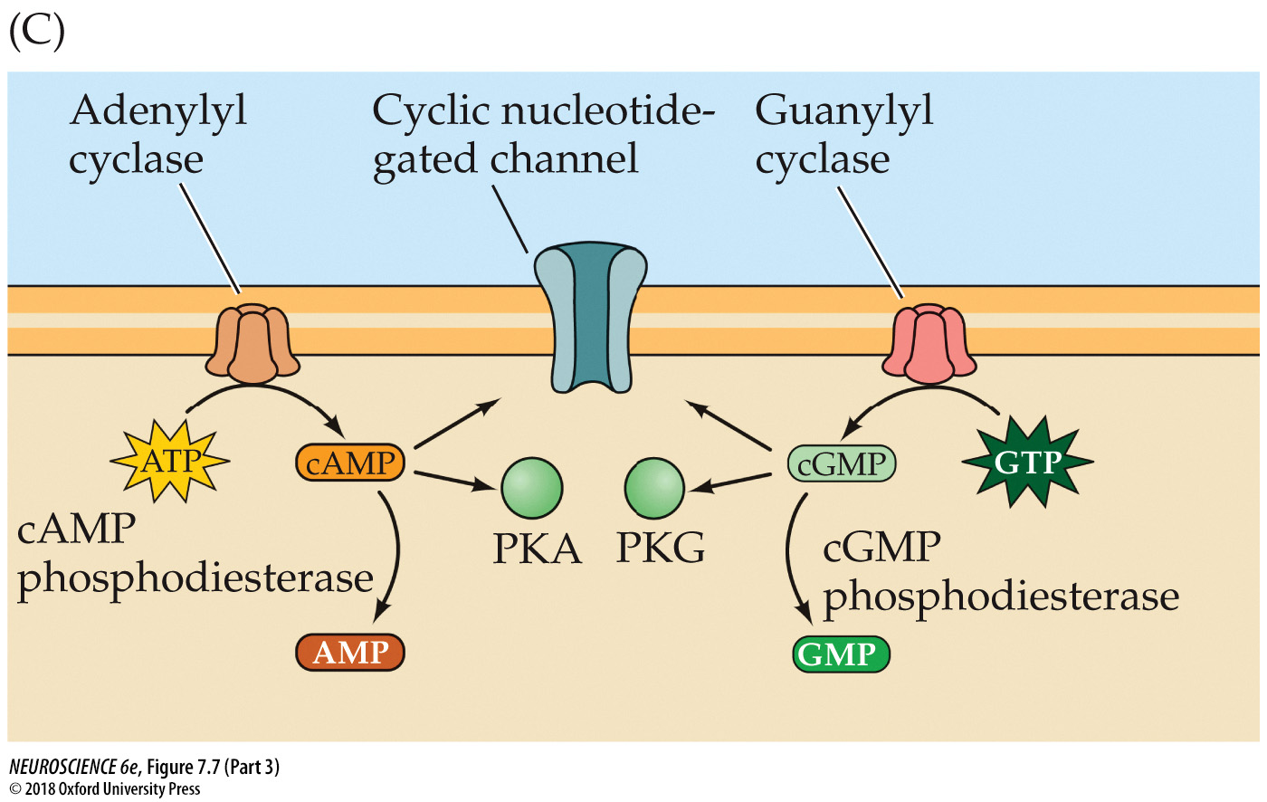
cAMP and cGMP
cAMP activates PKA
cGMP activates PKG
Phosphodiesterases cleave cAMP to AMP and cGMP to GMP to stop signal transduction

Slide 15
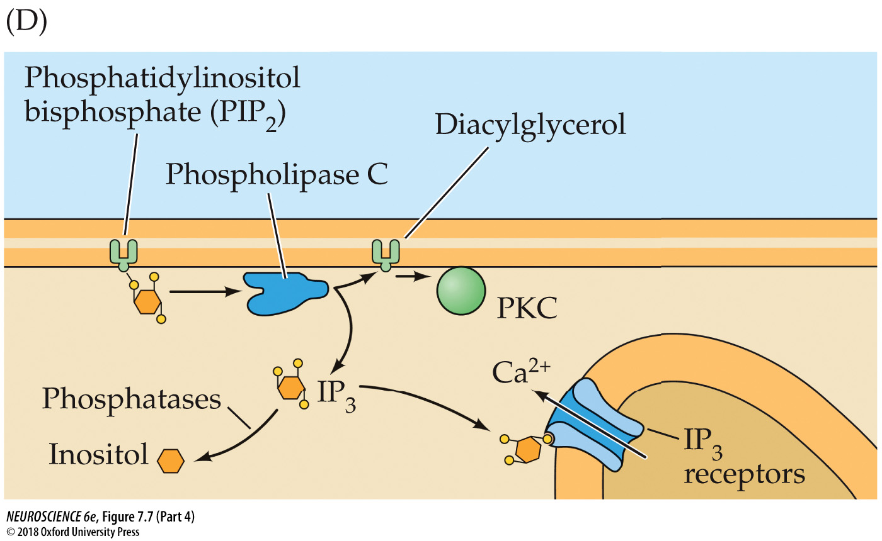
IP3 and DAG
IP3 releases Ca²⁺ from intracellular stores
  Inactivated by phosphatases
DAG activates protein kinase C (PKC)
  Inactivated by several enzymes

Slide 16

Calcium is the Most Common 2nd Messenger
Common targets:
  Calmodulin
  Various protein kinases and phosphatases
  Ion channels
  Synaptotagmin
Notes:
.

Slide 17
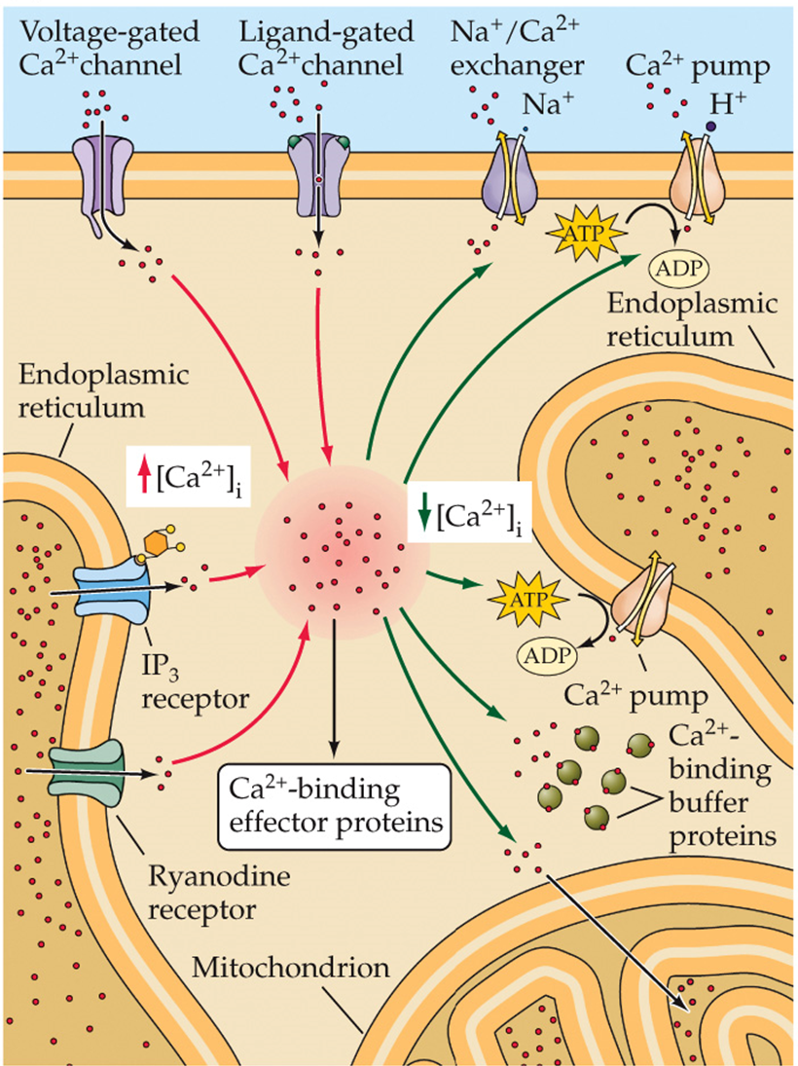
Calcium Regulation
Increasing intracellular levels of Ca²⁺
  V-gated Ca²⁺ channels
  ligand-gated Ca²⁺ channels
  Release from intracellular stores
Decreasing intracellular levels of Ca²⁺
  Na⁺/Ca²⁺ exchanger
  Ca²⁺ pumps
  calbindin

Slide 18
Summary
4 receptor types result in 4 different modes of signal transduction
Intracellular signaling cascades allow for signal amplification
G protein coupled receptors activate by exchanging GDP for GTP. They are inactivated by hydrolyzing GTP back into GDP
Activated g proteins can activate or inactivate different effector proteins
Effector proteins produce 2nd messengers
2nd messengers mostly activate kinases or phosphatases
Calcium is the most common 2nd messenger and impacts various important cellular functions.

